Slide 1

THE EFFECTIVENESS OF EDUCATION OF PEOPLE ON SUSTAINABILITY THROUGH THE MEDIUM OF AGRICULTURAL PRODUCTS AND RELATED PRACTICES FROM THE PARK OF PARNASSOS AND THE SURROUNDING AREA.

Slide 2
Introduction
Sustainability
People
Education
Food
Locality, seasonality and availability of resources
The effectiveness of education of people on sustainability through the medium of agricultural products from and related practices in the Park of Parnassos and the surrounding area.

Slide 3
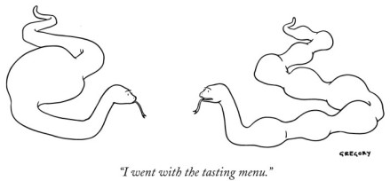
METHODOLOGY
literature research
desktop research
interviews and conversations with experts
field research and observations
personal experiences and exchange of opinions
degustation
The effectiveness of education of people on sustainability through the medium of agricultural products from and related practices in the Park of Parnassos and the surrounding area.

Slide 4
Results & Discussion
Effective education and awareness raising method
Intergenerational workshops combined with social entrepreneurship
Responsible Environmental Consumer Behavior
Intangible Cultural Heritage
Involving diverse groups of stakeholders (local people, local authorities, visitors, youth, NGOs)
The effectiveness of education of people on sustainability through the medium of agricultural products from and related practices in the Park of Parnassos and the surrounding area.

Slide 5
CONCLUSION & RECOMMENDATIONS
It is an effective educational method.
Main guideline: “If an activity is said to be sustainable, it should be able to continue forever.”
Local Food Bank and wider Food Bank Network
Green gastronomy, seasonal culinary schools and workshops
Link local events with international movements (e.g. Slow Food, Locavore)
Database of cultural events, foods, locations, seasons and travellers’ information.
…and many, many more… (e.g. fundraising events)
The effectiveness of education of people on sustainability through the medium of agricultural products from and related practices in the Park of Parnassos and the surrounding area.

Slide 6
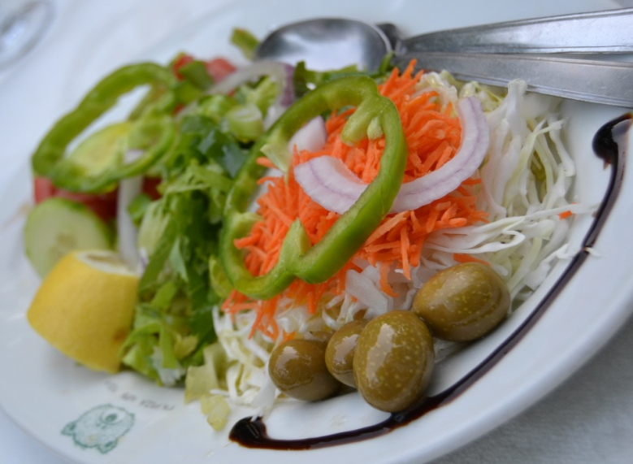

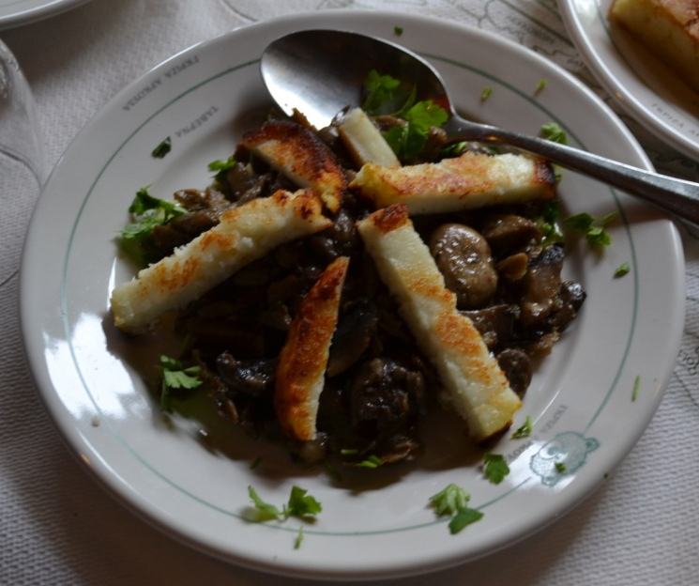
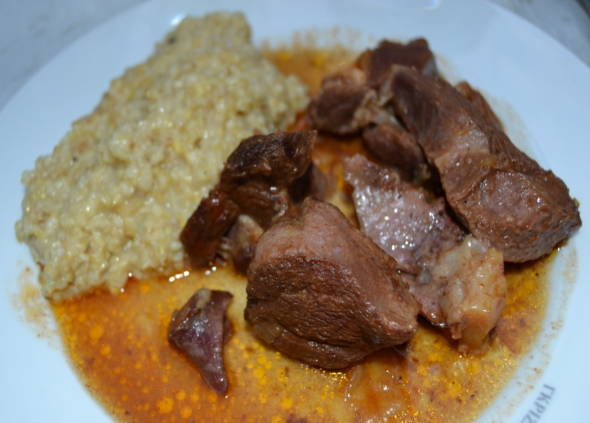
JANINA
ELITSA
THANK YOU!
CHRISTINA
PERRINE
The effectiveness of education of people on sustainability through the medium of agricultural products from and related practices in the Park of Parnassos and the surrounding area.

